Slide 1
Microbial pesticides

Slide 2
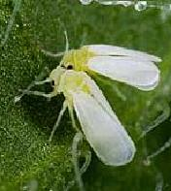
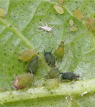
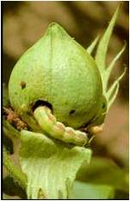
Food security and challenges
Feeding 9 billion by 2050
Global demand for food- 70 % by 2050
30 % loss of stored food (Boyer et al., 2011)
More than 3 million people are killed- malaria (Ansari et al., 2014)
Bemisia tabaci (whitefly)
Aphis gossypii (Cotton aphid)
Helicoverpa armigera (cotton bollworm)
Changes in climatic conditions, pest re-emergence, - threatening
agricultural production (Sundstrom et al., 2014)

Slide 3

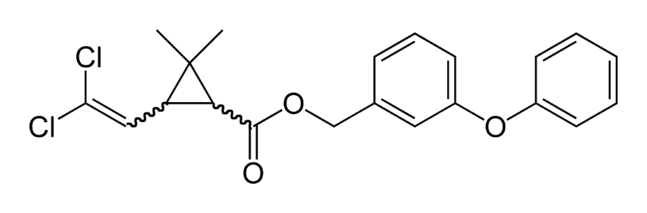
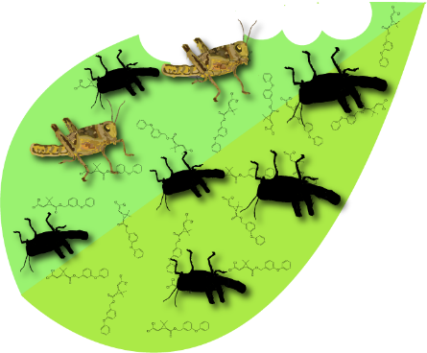
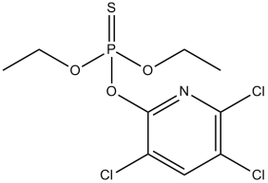
Insecticide resistance
Pyrethroid
Organophosphate
Pesticide usage
Insect resistance
to pesticides
4.6 million tonnes of pesticides (Ansari et al., 2014)
B. tabaci- pyrethroid- Vgsc and Ace gene (Gauthier et al., 2014)
Spodoptera litura- profenofos- Ace gene (Su et al., 2014)

Slide 4
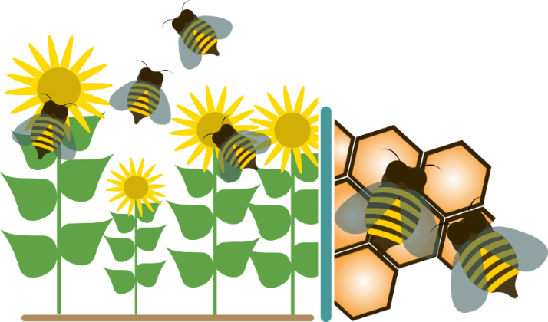


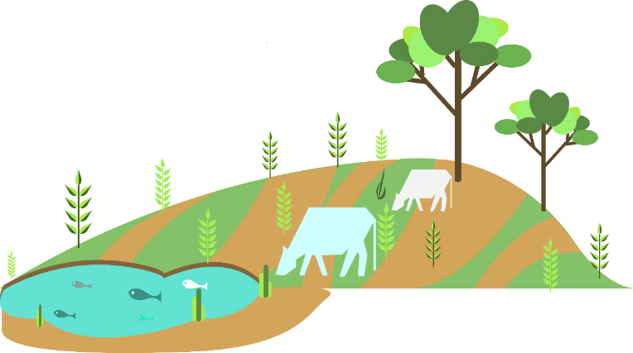
Effects on Non-target organisms
Biodiversity Loss
1 in 3 crops pollination
Colony Collapse Disorder
Imbalance in terrestrial ecosystem stability
Crop productivity
Human welfare
Environmental problem

Slide 5
Insect resistance to insecticides
Targets- Acetylcholine esterase, Voltage Gated Channels, Hormones (Hardy, 2014)
Pyrethroids, organophosphates, DDT
Globally, 4.6 million tonnes of pesticides (Ansari et al., 2014)
Mechanisms- detoxification by cytochrome P450, mutations in targeted sites (Zimmer et al., 2014)
B. tabaci- pyrethroid- Vgsc and Ace gene (Gauthier et al., 2014)
Spodoptera litura- profenofos- Ace gene (Su et al., 2014)
Anopheles gambiae sensu lato - deltamethrin and DDT (Nkya et al., 2014)

Slide 6
Environmental and human health risks
Effects on non target organisms
Pollinators- Biodiversity maintainer
71 of 100 crops are pollinated by bees
Imbalance in terrestrial ecosystem stability Crop productivity Human welfare
Imidacloprid- Field level exposure- reduced colony growth and
85 % reduction in Queen Bee production (Whitehorn et al., 2012)
3 million cases of pesticide poisoning each year; up to 2,20,000 deaths,
primarily in developing countries (WHO report)

Slide 7
Biopesticides
“Any molecules from the biological origin, whole organism or product derived from them” (Villaverde et al., 2014)
Bacteria
Bacillus thuringiensis (Bt)- Cry, Cyt, Vip
Ostrinia nubilalis- major pest of corn (Crava et al., 2014), S. exigua (Beet army worm) (Naimov et al., 2014)
Virus
Baculovirus- Itch mite toxin Txp-1- Increased mortality to 50-60% (Burden et al., 2000)
Fungi
Lecanicillium lecanii , Isaria fumosorosea, Beauveria, and Metarhizium

Slide 8
Biological pesticides
“Any molecules from the biological origin, whole organism or product derived from them” (Villaverde et al., 2014)
Bacillus thuringiensis (Bt)
Cry, Cyt, Vip
Bacteria
Needs to be ingested to act
Virus
Baculovirus
Beauveria, Metarhizium,
Lecanicillium lecanii
Isaria fumosorosea,
Acts by direct penetration (or)
Contact infection
Fungi

Slide 9
Bacillus thuringiensis

Slide 10
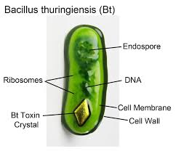
Bacillus thuringiensis
Bacillus thuringiensis (or Bt) is a Gram-positive, soil-dwelling bacterium, commonly used as a biological pesticide.
B. thuringiensis also occurs naturally in the gut of caterpillars of various types of moths and butterflies.
During sporulation, many Bt strains produce crystal proteins (proteinaceous inclusions), called δ-endotoxins, that have insecticidal action.
This has led to their use as insecticides, and more recently to genetically modified crops using Bt genes, such as Bt corn.
The subspecies israelensis is commonly used for control of mosquitoes

Slide 11
Bacillus thuringiensis
Bt was isolated in 1901 and named in 1911. It was used as a commercial biopesticide for the first time in the United States in 1958.
Delta endotoxins (δ-endotoxins) are pore-forming toxins produced by Bacillus thuringiensis species of bacteria.
During spore formation the bacteria produce crystals of such proteins (hence the name Cry toxins) that are also known as parasporal bodies, next to the endospores; as a result some members are known as a parasporin.
The Cyt (cytolytic) toxin group is a group of delta-endotoxins different from the Cry group.
The activated region of the delta toxin is composed of three distinct structural domains: an N-terminal helical bundle domain involved in membrane insertion and pore formation; a beta-sheet central domain involved in receptor binding; and a C-terminal beta-sandwich domain that interacts with the N-terminal domain to form a channel

Slide 12
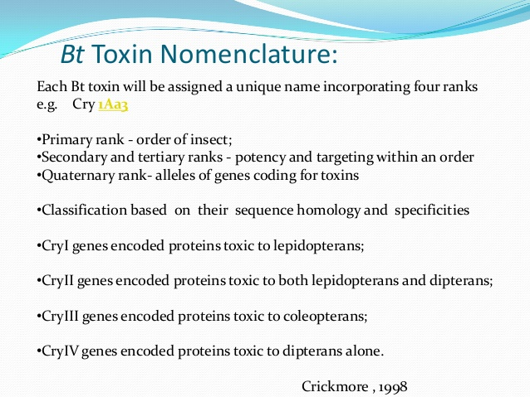

Slide 13
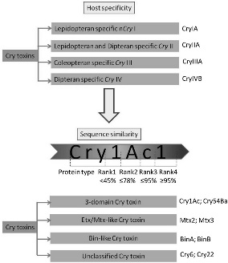

Slide 14
Mode of action:
When insects ingest toxin crystals, their alkaline digestive tracts denature the insoluble crystals, making them soluble and thus amenable to being cut with proteases found in the insect gut, which liberate the toxin from the crystal.
The Cry toxin is then inserted into the insect gut cell membrane, paralyzing the digestive tract and forming a pore.
The insect stops eating and starves to death; live Bt bacteria may also colonize the insect, which can contribute to death.
Death occurs within a few hours or weeks. The midgut bacteria of susceptible larvae may be required for B. thuringiensis insecticidal activity.

Slide 15
Mode of action:
Stage I – Proteolysis of protoxins in the insect gut to generate active toxin fragments
The midgut pH and proteolytic enzymes present in different insect orders – determinants of the selective toxicity of particular Cry protoxins.
Lepidoptera – Highly alkaline (9.5-10.5), proteases present are typsins and chymotrypsins.
Coleoptera – pH range is 5.5 to 8.0 and aspartic and cysteine proteases
Stage II- Binding of Cry toxins to specific receptors on midgut epithelial cells
Bt action is very specific. Different strains of Bt are specific to different receptors in insect gut wall.
Bt toxicity depends on recognizing receptors, damage to the gut by the toxin occurs upon binding to a receptor.
Each insect species possesses different types of receptors that will match only certain toxin proteins, like a lock to a key.

Slide 16
Mode of action:
Stage III – Formation of transmembrane pores
Binding leads – toxin gets localized at the external surface of the cytoplasmic membrane of epithelial cells of the midgut brush border membrane and binding induces a conformation change in the toxin which is necessary for membrane insertion
Upon insertion the toxin oligomerizes and forms transmembrane cation selective pores
The pores allow equilibration of cation concentrations across the membrane. The entry of Na⁺ ions with an accompanying influx of water leads to swelling and rupture of the cell wall.
Stage IV – Bacteremia/Septicimia
The larvae stops feeding and ultimately dies. The vegetative cells of Bt that germinate from the ingested spores are able to enter the haemolymph through the damaged epithelial cell layer and multiply.

Slide 17
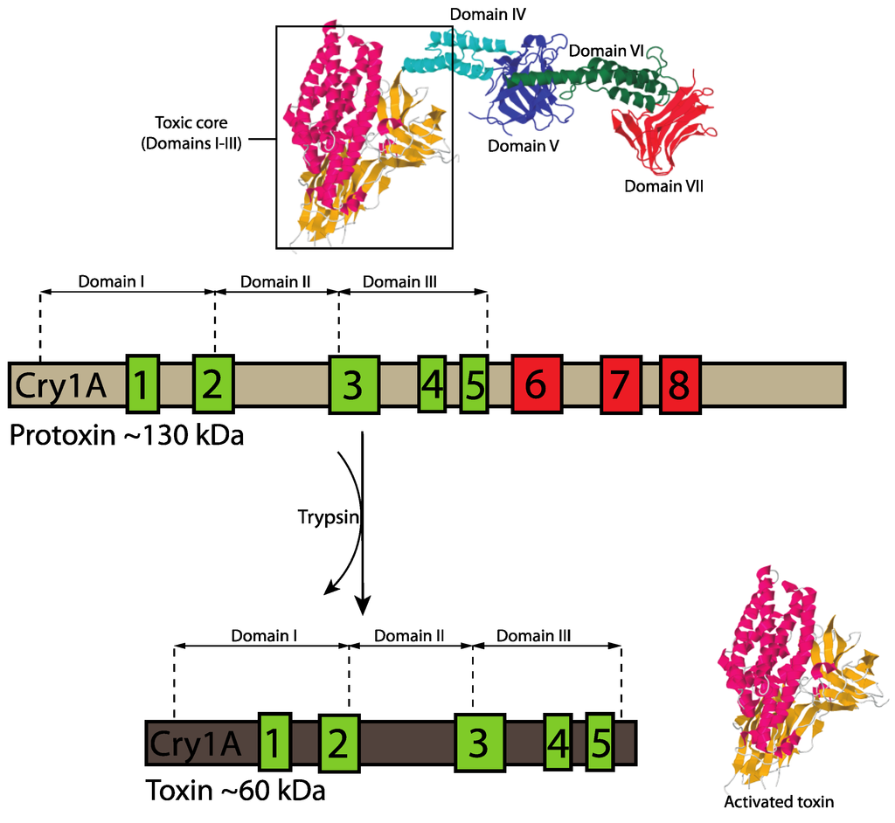
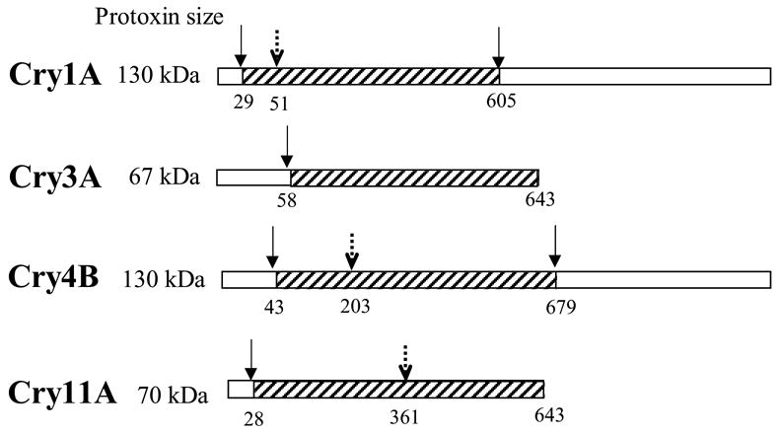

Slide 18
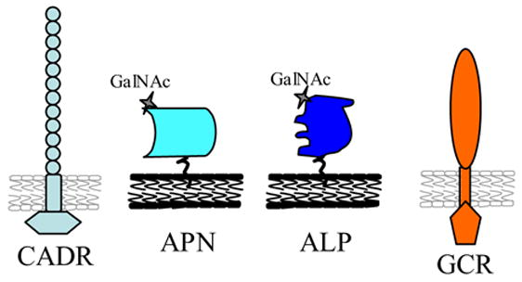
Receptors
Receptor molecules of Cry1A proteins. CADR, cadherin receptor; APN, aminopeptidase-N, ALP, alkaline phosphatase, GCR, 270 kDa glyco-conjugate receptor.
Bt action is very specific. Different strains of Bt are specific to different receptors in insect gut wall.
Bt toxicity depends on recognizing receptors, damage to the gut by the toxin occurs upon binding to a receptor.
Each insect species possesses different types of receptors that will match only certain toxin proteins, like a lock to a key.

Slide 19
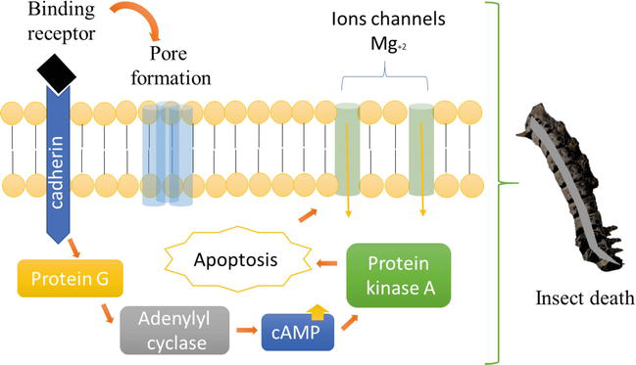

Slide 20
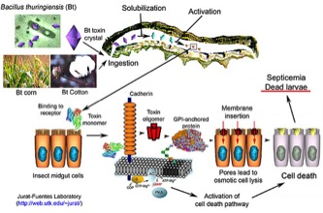

Slide 21
